Slide 1









Whiteboardmaths.com
7
2
1
5
© 2004 All rights reserved

Slide 2

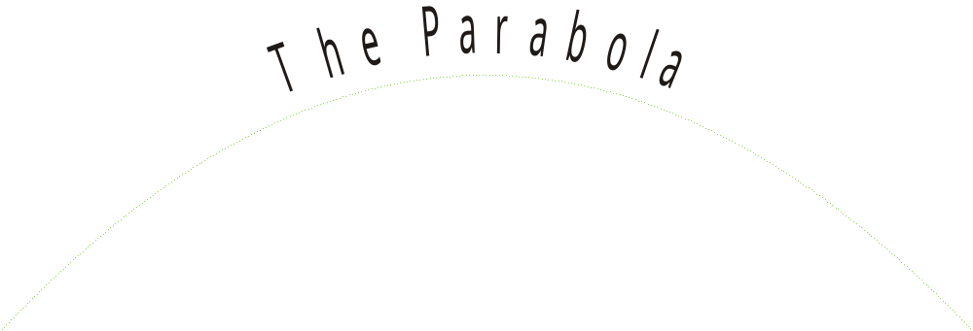


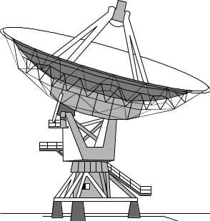

y = ax²
Satellite Dish
Path of a Moving Object
Single Focus
Receiver
Transmitter
A Parabolic device has a single focus. This enables radiation to be received and amplified or transmitted and amplified.
Radio Telescope
Torch Reflector

Slide 3
y
10
9
8
y = x²
7
6
5
4
y = x² - 5
3
2
1
x
-10
-9
-8
-7
-6
-5
-4
-3
-2
-1
0
1
2
3
4
5
6
7
8
9
10
y = x² + 1
-1
-2
-3
-4
-5
-6
-7
-8
-9
-10

Slide 4
y
20
19
18
y = x²
17
16
15
14
y = 2x²
13
12
11
10
y = 3x²
9
8
7
As the coefficient of x² becomes larger, the curve becomes compressed in the x direction towards the y axis .
6
5
4
3
2
1
x
-10
-9
-8
-7
-6
-5
-4
-3
-2
-1
0
1
2
3
4
5
6
7
8
9
10

Slide 5
y
10
9
y = x²
8
7
6
y = ½x²
5
4
3
y = ¼x²
2
1
x
-10
-9
-8
-7
-6
-5
-4
-3
-2
-1
0
1
2
3
4
5
6
7
8
9
10
-1
-2
-3
As the the coefficient of x becomes smaller, the curve opens up. It is stretched in the x direction away from the y axis.
-4
-5
-6
-7
-8
-9
-10

Slide 6
8
y
Equation of Line of symmetry is x = 1
Drawing quadratic graphs of the form y = ax² + bx + c
7
LoS
6
5
Example 1.
4
3
y = x² - 2x - 8
2
x | -3 | -2 | -1 | 0 | 1 | 2 | 3 | 4 | 5
x²
-2x
-8
y
1
x
-3
-2
-1
0
1
2
3
4
5
9
4
1
0
1
4
9
16
25
-1
6
4
2
0
-2
-4
-6
-8
-10
-2
-3
-8
-8
-8
-8
-8
-8
-8
-8
-8
-4
7
0
-5
-8
-9
-8
-5
0
7
-5
-6
Minimum point
at (1, -9)
-7
-8
-9

Slide 7
y
8
Example 2.
LoS
7
y = x² + 5x + 2
6
x
-6
-5
-4
-3
-2
-1
0
1
5
x²
36
25
16
9
4
1
0
1
4
3
5x
-30
-25
-20
-15
-10
-5
0
5
2
2
2
2
2
2
2
2
2
2
1
y
8
2
-2
-4
-4
-2
2
8
-6
-5
-4
-3
-2
-1
0
1
2
3
4
x
-1
Drawing quadratic graphs of the form y = ax² + bx + c
-2
-3
-4
-5
Minimum point
at (-2½, -4¼)
approximately
Equation of Line of Symmetry is x = - 2½
-6
-7
-8

Slide 8
y
y
y = -x² - 5x - 2
A negative x² term inverts the curve.
x
0
0
x
y = -x² + 2x + 8

Slide 9
8
y
7
Example question
6
(a) Draw the graph of y = x² - 4x - 5
(b) Write down the co-ordinates of the minimum point.
(c) Write down the equation of the line of symmetry.
(d) Find the value of y when x = 2½.
(e) Find the values of x when y = -8.
5
4
3
2
1
x
-3
-2
-1
0
1
2
3
4
5
6
-1
-2
-3
(a)
(b)
(c)
(d)
(e)

-4
(2, -9)
-5
x = 2
-6
y = -8.7 (approx)
-7
x = 1 and 3
-8
-9

Slide 10
y
1
2
y
x
y
3
x
x

Slide 11
8
y
7
6
5
Example 1
4
3
y = x² - 2x - 8
2
x
-3
-2
-1
0
1
2
3
4
5
1
x
-3
-2
-1
0
1
2
3
4
5
x²
-1
-2x
-2
-8
-3
-4
y
-5
-6
-7
-8
-9

Slide 12
y
8
Example 2
7
y = x² + 5x + 2
6
x
-6
-5
-4
-3
-2
-1
0
1
5
x²
4
3
5x
2
2
1
y
-6
-5
-4
-3
-2
-1
0
1
2
3
4
x
-1
-2
-3
-4
-5
-6
-7
-8

